Slide 1

Consumer Goods Ad Hoc Insights

Slide 2

Request
What is the percentage of unique product increase in 2021 vs. 2020?
Output

Slide 3
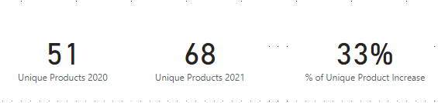
Conversion of Output to Visual
Insights
The total number of unique products increased by 33% from 2020 to 2021, rising from 51 to 68. This growth highlights a successful year in product expansion.

Slide 4
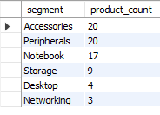
Request
Provide a report with all the unique product counts for each segment and sort them in descending order of product counts.
Output

Slide 5
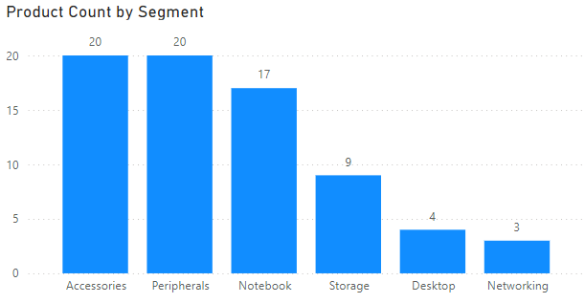
Conversion of Output to Visual
Insights
Both Accessories and Peripherals segments represents 27.4% of the total product count, indicating its importance in catering to everyday consumer needs.
The Networking segment, while smaller in product count at 4.11% represents a critical area for customer engagement and value-added offerings.

Slide 6
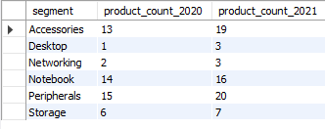
Request
Which segment had the most increase in unique products in 2021 vs 2020?
Output

Slide 7
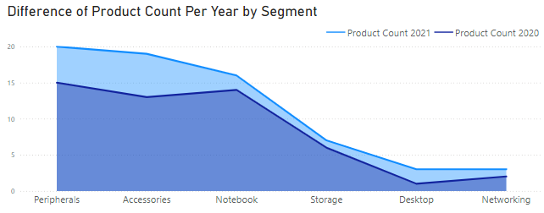
Conversion of Output to Visual
Insights
The Peripherals and Accessories segment experienced the largest growth, with a 46.15% increase of Peripheral while 33.33% in Accessories, indicating strong market trends in these areas.
Based on the significant increases observed, the focus should be on further expanding offerings in the Peripherals and Accessories segments, while monitoring emerging trends in Sustainable Products.

Slide 8

Request
Get the products that have the highest and lowest manufacturing costs
Output

Slide 9
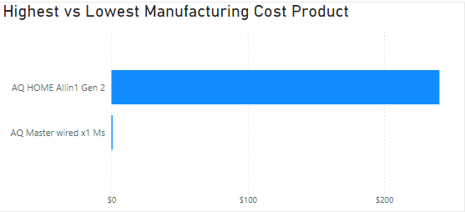
Conversion of Output to Visual
Insights
Position high-cost products as premium offerings with targeted marketing to justify their higher price. For low-cost products, emphasize value and affordability in your marketing and explore bulk sales or partnerships to boost volume.

Slide 10
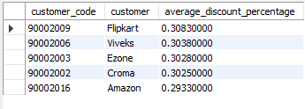
Request
Generate a report which contains the top 5 customers who received an average high pre invoice discount % for the fiscal year 2021 and in the Indian market.
Output

Slide 11
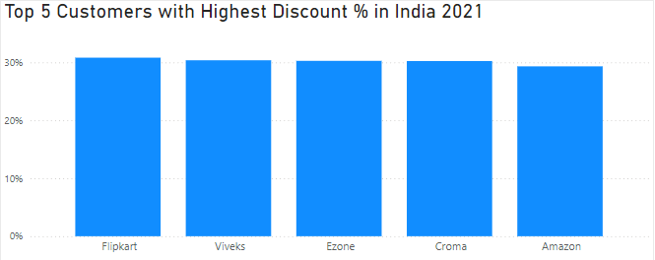
Conversion of Output to Visual
Insights
Track the long-term impact of these discounts on customer retention and profitability. Assess whether the discounts have led to sustained relationships and increased business, or if they need adjustment to balance customer loyalty with profit margins.

Slide 12
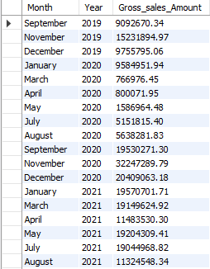
Request
Get the complete report of the Gross sales amount for the customer “Atliq Exclusive” for each month.
Output

Slide 13
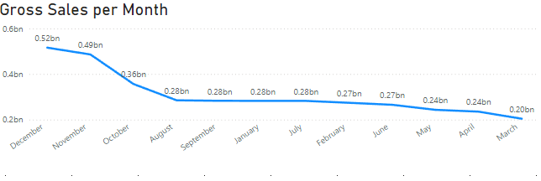
Conversion of Output to Visual
Insights
The customer ‘Atliq Exclusive’ experienced a decline in gross sales, with a 15% decrease in monthly sales over the past three months. This downward trend highlights a potential issue with customer engagement or market conditions, warranting further investigation and possible strategic adjustments

Slide 14

Request
Which quarter of 2020, got the maximum Total Sold Quantity.
Output

Slide 15
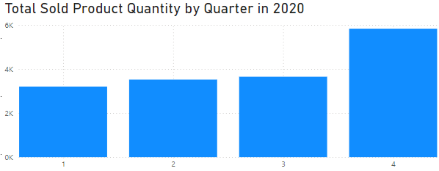
Conversion of Output to Visual
Insights
In 2020, sales were lowest in Q1. Q2 saw a 5% increase, while Q3 experienced a 7% rise. The highest sales were in Q4, with a 15% increase compared to Q3, highlighting a strong year-end recovery.

Slide 16

Request
Which channel helped to bring more gross sales in the fiscal year 2021 and the percentage of contribution
Output

Slide 17
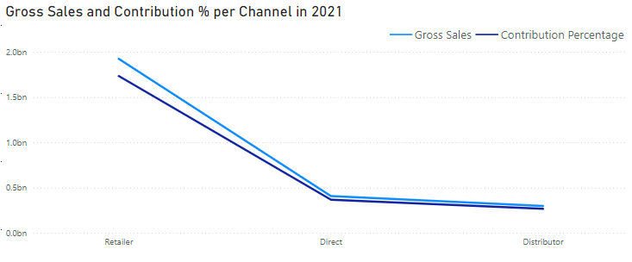
Conversion of Output to Visual
Insights
In fiscal year 2021, the Retailer channel was the most significant contributor to gross sales, accounting for 60% of the total Sales
In fiscal year 2021, the Distributor channel had the lowest gross sales at 20%, a 15% decline from the previous year, suggesting a need to optimize distributor relationships and explore new market opportunities.

Slide 18

Request
Get the Top 3 products in each division that have a high Total Sold Quantity in the fiscal year 2021
Output

Slide 19
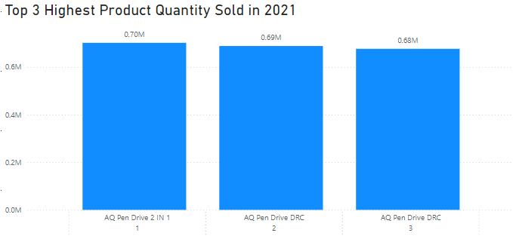
Conversion of Output to Visual
Insights
In fiscal year 2021, within the N & S division, the top 3 products with the highest total sold quantities AQ Pen Drive 2 IN 1, AQ Pen Drive DRC. These products demonstrated exceptional market performance and demand, suggesting that enhancing inventory and promotional efforts for these top sellers could further boost sales in this division.

